Slide 1
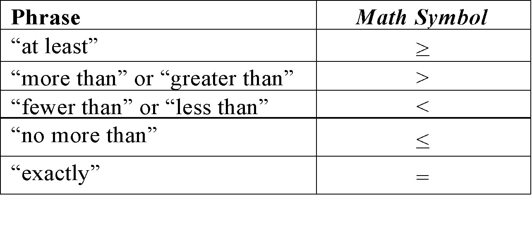
Understandings
1

Slide 2
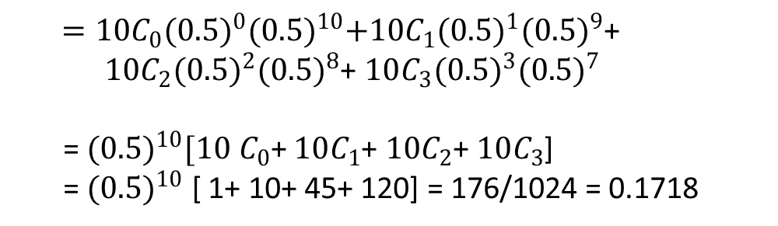
Example 2:
Ten coins are thrown simultaneously. what is the probability of getting 3 or fewer heads?
Solution:
P(x ≤ 3) = ∑p(x) = P(0)+ P(1)+ P(2)+P(3)
$=10C_{0}{(0.5)}^{0}{(0.5)}^{10}+10C_{1}{(0.5)}^{1}{(0.5)}^{9}$+
$10C_{2}{(0.5)}^{2}{(0.5)}^{8}$+ $10C_{3}{(0.5)}^{3}{(0.5)}^{7}$
= ${(0.5)}^{10}[10$ $C_{0}$+ $10C_{1}$+ $10C_{2}$+ $10C_{3}$]
= ${(0.5)}^{10}$ [ 1+ 10+ 45+ 120] = 176/1024 = 0.1718
P(x ≤ 3) = ∑p(x) = 0.1718
2

Slide 3
Example 3:
A pair of dice is rolled 5 times. If getting the product of 6 is considered as a success. Find the probability of getting at least 4 successes.
Solution:
The formula for the above probability is given by:
P (X = x) = ^{n}C_{x} p^{x} q^{n-x}
Here, n = 5
p is the probability of getting product 6 [(1,6) (6,1) (2,3) (3,2)]
p = 4 /36 = 1/9
q = 1 - p = 8/9
⇒ P(X ≥ 4) = P(X = 4) + P(X = 5)
⇒ P(X ≥ 4) = ⁵C₄ (1/9)⁴ (8/9)⁵⁻⁴+ ⁵C₅ (1/9)⁵ (8/9)⁵⁻⁵
⇒ P(X ≥ 4) = 5(1/9)⁴ (8/9) + (1/9)⁵
^{= 0.000694335}
3

Slide 4
Example 4:
Each of five questions on a multiple-choice examination has four choices, only one of which is correct. The student is attempting to guess the answers. The random variable X is the number of questions answered correctly. What is the probability that the student will get
a) exactly three correct answers?
b) at most three correct answers?
c) at least one correct answer?
d) Find Mean and variance.
4

Slide 5
Solution: p=1/4, n=5, q=3/4;
a)P(X=3)= 45/512 = 0.08789
b) P(X<=3)=63/64;
c) P(X>=1)= 0.7627
d) Mean = 5/4
Variance = 15/16.
5

Slide 6
Example 5:
Find the binomial distribution if the mean is 6 and variance is 4.
Solution: n=18, p=1/3;
6

Slide 7
Example 6:
In a large number of parts manufactured by a machine , the mean number of
defectives in a sample of 20 is 2. Out of 1000 such samples , how many would be
expected to contain atleast 3 defective parts.
Sol: Given n=20;
Therefore the probability that there are atleast 3 defective parts in a sample of 20 is
Hence out of 1000 samples we get 0.323*1000=323 samples
7

Slide 8
Recall : Binomial Distribution
A binomial experiment is a probability experiment that satisfies the following conditions.
1. The experiment is repeated for a fixed number of trials, where each trial is independent of other trials.
2. There are only two possible outcomes of interest for each trial. The outcomes can be classified as a success (S) or as a failure (F).
3. The probability of a success P (S) is the same for each trial.
4. The random variable x counts the number of successful trials.
8

Slide 9
Poisson Distribution
Poisson distribution is suitable for rare events for which the probability of occurrence ‘p’ is very small and the number of trials ‘n’ is very large.
Also, binomial distribution can be approximated by Poisson distribution when
n→∞ and p →0 such that λ= np = constant
9

Slide 10
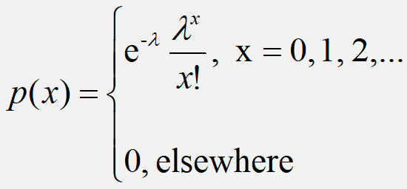
Poisson Distribution
A random variable ‘X’ is said to have Poisson distribution if its probability mass function is given by
Definition
Poisson distribution is the discrete probability distribution of a discrete random variable X, which may not have upper bound. It is defined for non negative values of x .
10

Slide 11
Example 6:
Telephone calls enter a college switchboard on the average of two every three minutes. What is the probability of 5 or more calls arriving in a 9-minute period?
Solution:
11

Slide 12
Example 7:
If 3% of electronic units manufactured by a company are defective. Find the probability that in a sample of 200 units, less than 2 bulbs are defective.
Solution:
The probability of defective units p = 3/100 = 0.03
Give n = 200.
We observe that p is small and n is large here. Thus, it is a Poisson distribution.
Mean λ= np = 200 × 0.03 = 6
P(X= x) is given by the Poisson Distribution Formula as (e^{-λ} λ^{x} )/x!
P(X < 2) = P(X = 0) + P(X= 1)
=(e⁻⁶ 6⁰ )/0! + (e⁻⁻⁶6¹ )/1!
= e⁻⁶ + e⁻⁻⁶ × 6
= 0.00247 + 0.0148
P(X < 2) = 0.01727
12

Slide 13
Example 8:
The number of customers arriving at a cafeteria at an average rate of 0.3 per minute.
(a) Find the probability that exactly 2 customers arrive in a 10-minute
span.
(b) Find the probability that 2 or more customers arrive in a 10-minute
span.
(c) Find the probability that exactly one customer arrives in a 5-minute
span and one customer arrives in the next 5-minute span.
13

Slide 14
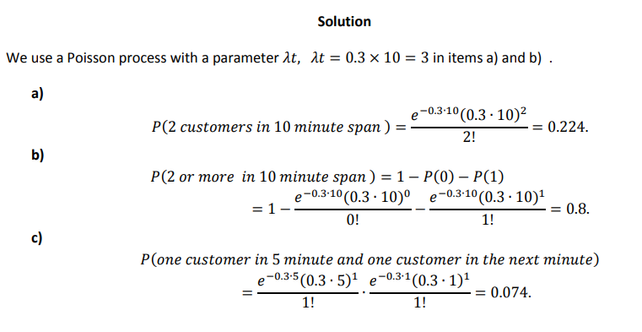
0.3.10
0.001115
14

Slide 15
Mean and Variance
Mean:
For a Poisson random variable, the variance and mean are the same!
Variance and Standard Deviation
where λ= expected number of occurrences in a given experiment.
15

Slide 16
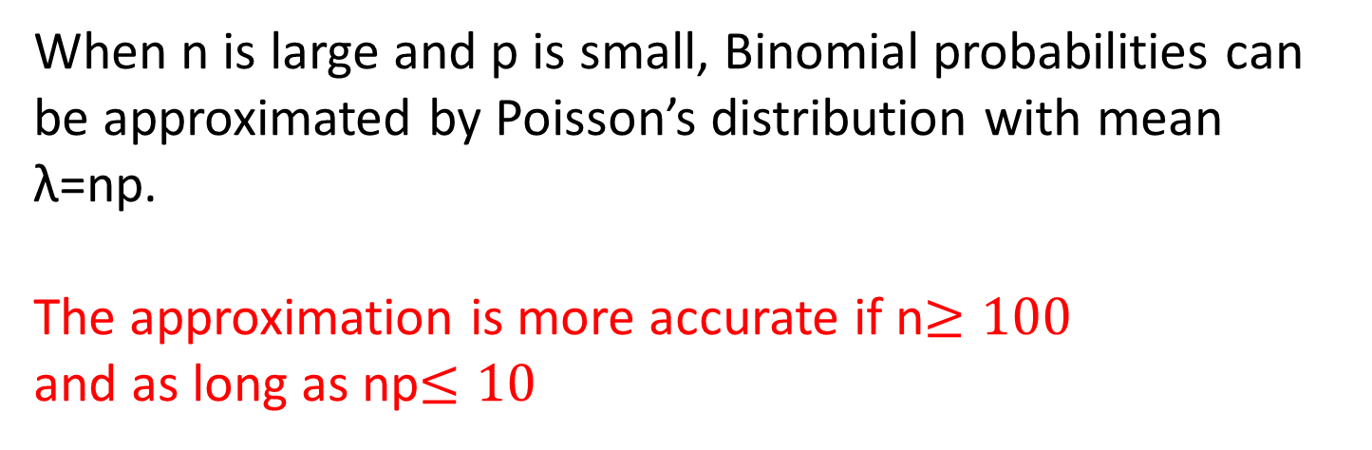
Poisson approximation to Binomial distribution :
When n is large and p is small, Binomial probabilities can be approximated by Poisson’s distribution with mean λ=np.
The approximation is more accurate if n$≥100$
and as long as np$≤10$
16

Slide 17
Example 9:
It is known that 5% of the books bound at a certain bindery have defective bindings. Find the probability that 2 of 100 books bound by this bindery will have defective bindings using
(a)The formula for the binomial distribution;
(b)The Poisson approximation to the binomial distribution
17

Slide 18
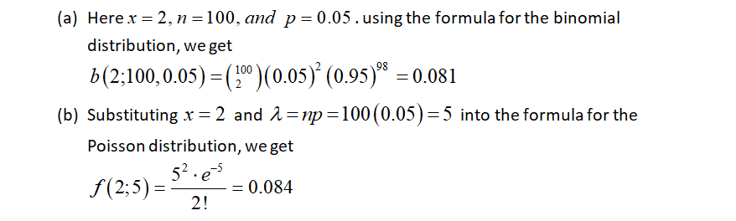
Solution:
18

Slide 19
Example 10:
Given that a switch board of a consultant’s office receives on the average 0.6 calls per minute, find the probabilities that
(a) in a given minute there will be at least 1 call;
(b) in a 4-minute interval there will be at least 3 calls.
19

Slide 20
Solution:
a) Here,
b)
20

Slide 21
Poisson Distribution: Applications
Arrivals at queuing systems:
Airports : people, airplanes, automobiles, baggage
Banks: people, loan applications
computer file servers : read and write operations
Defects in manufactured goods:
number of defects per 1,000 feet of extruded copper wire
number of blemishes per square foot of painted surface
number of errors per typed page
21

Slide 22
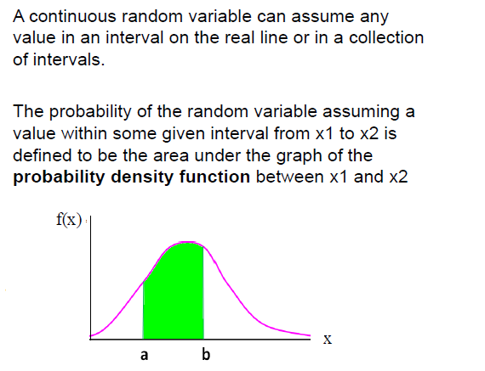
RECALL: Continuous Random Variables
Example:
Height of students in a class
Amount of ice tea in a glass
Change in temperature throughout a day
Price of a car in next year
22

Slide 23
Continuous Probability Distributions:
Normal Distribution:
Normal distribution is a general distribution. Any information such as heights, weights, lengths, widths, sizes, profits, prices, wages, time etc. containing sufficiently large data with mean and variance follows normal distribution.
The distribution of errors of repeated measurements follows normal distribution.
23

Slide 24
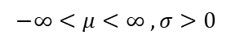
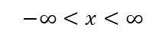
Normal Distribution
A continuous random variable X which assumes all possible values in
the entire real space, i.e., -∞<x<∞ is said to follow normal
distribution with two parameters such as mean μ and variance σ²
if it has the probability density function given by
$$−∞<x<∞$$
$$−∞<μ<∞ , σ>0$$
24

Slide 25
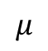
Normal Distribution
f(X)
Changing μ shifts the distribution left or right.
Changing σ increases or decreases the spread.
σ
$$μ$$
X
Properties:
1. Normal curve is bell shaped and symmetric about the mean
2. Mean = Mode = Median
3. Total area under normal curve is equal to 1
4. Normal curve approaches but never touches the x axis as it extends farther and farther away from the mean
25

Slide 26
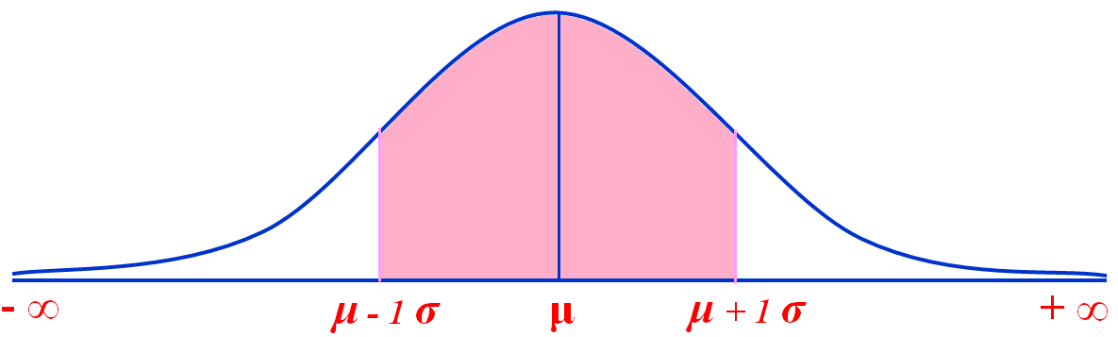
Area under normal curve
Area under the curve: Mean ± 1SD
34%
34%
68%
16%
16%
26

Slide 27
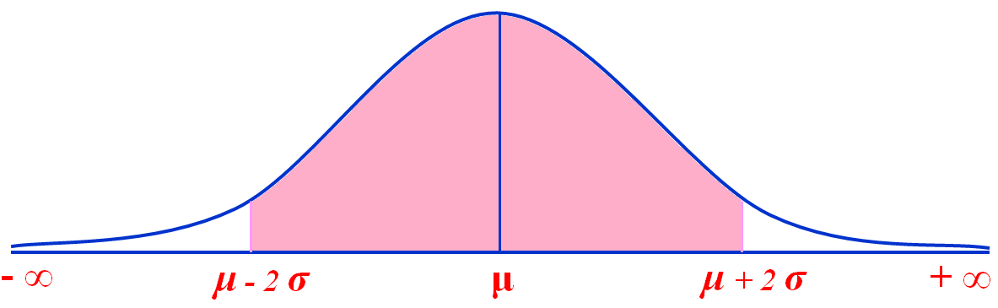
Area under normal curve
Area under the curve: Mean ± 2SD
47.5%
47.5%
95%
2.5%
2.5%
27

Slide 28
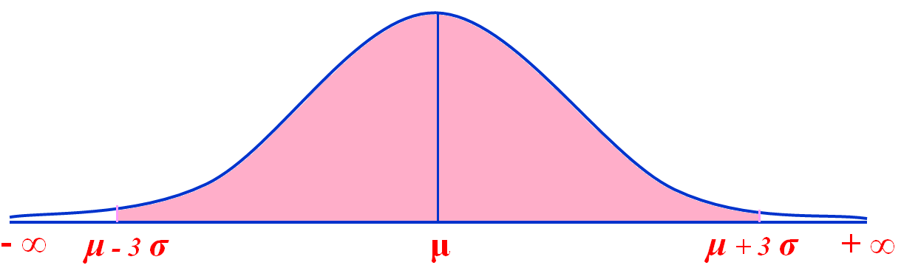
Area under normal curve
Area under the curve: Mean ± 3SD
49.99%
49.99%
99.97%
28

Slide 29
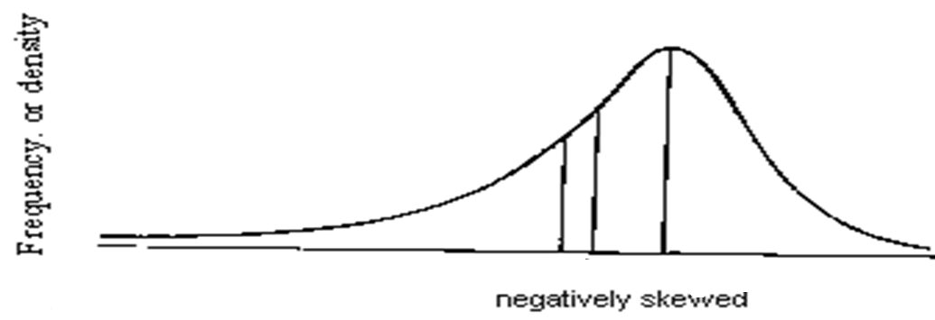
Skewness
Negatively skewed: The left tail is longer; the mass of the
distribution is concentrated on the right of the figure.
The distribution is said to be left-skewed.
29

Slide 30
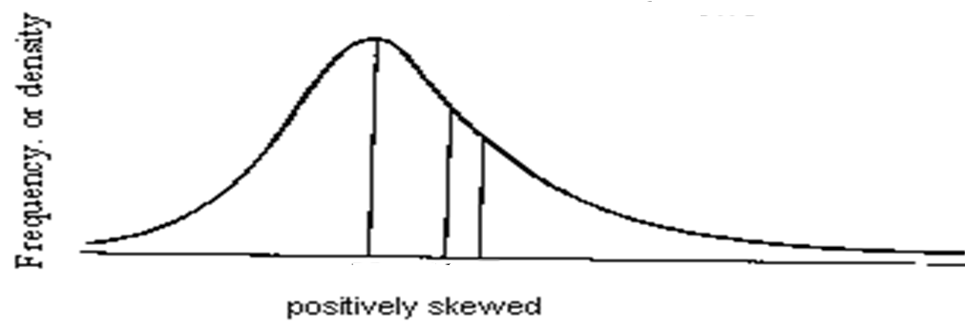
Skewness
Positively skewed: The right tail is longer; the mass of the
distribution is concentrated on the left of the figure.
The distribution is said to be right-skewed.
30

Slide 31
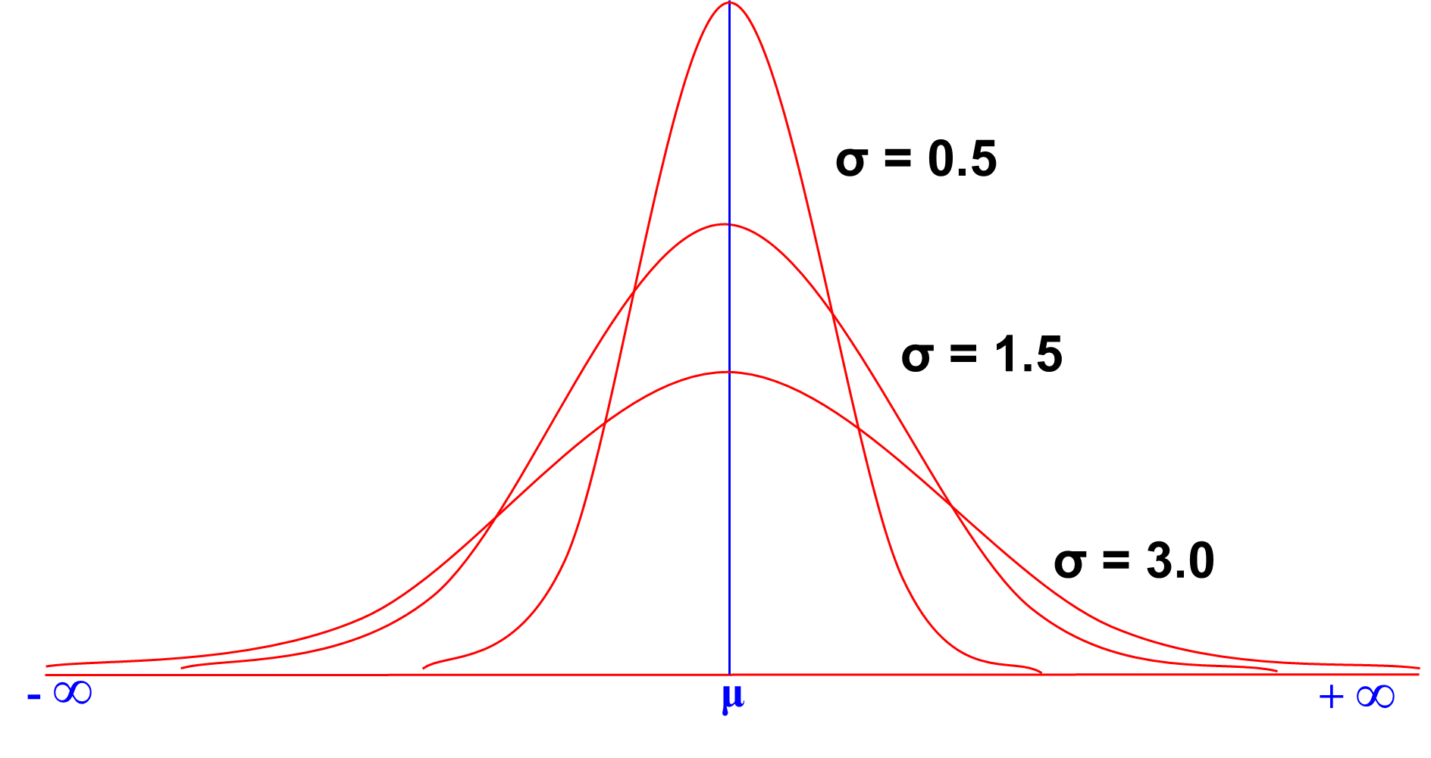
The Normal Distribution
31

Slide 32
Normal Distribution
E(X)=μ =
Var(X)=σ² =
Standard Deviation(X)= σ
No matter what μ and σ are, the area between μ-σ and μ+σ is about 68%; the area between μ-2σ and μ+2σ is about 95%; and the area between μ-3σ and μ+3σ is about 99.7%. Almost all values fall within 3 standard deviations.
32

Slide 33
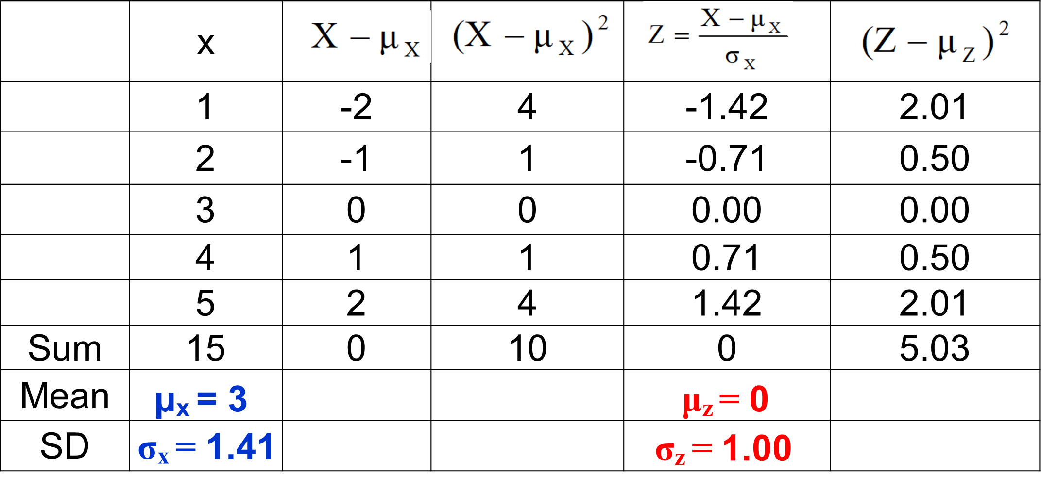
Why Standard Normal Distribution?
X ~ N(µ, σ²) → Z ~ N(0, 1). This is true for any data size
33

Slide 34
Standard Normal Distribution
The standard normal distribution is a normal distribution with a mean of 0 and a standard deviation of 1.
z
−3
−2
−1
0
1
2
3
All normal distributions can be converted into the standard normal curve by subtracting the mean and dividing by the standard deviation.
34

Slide 35
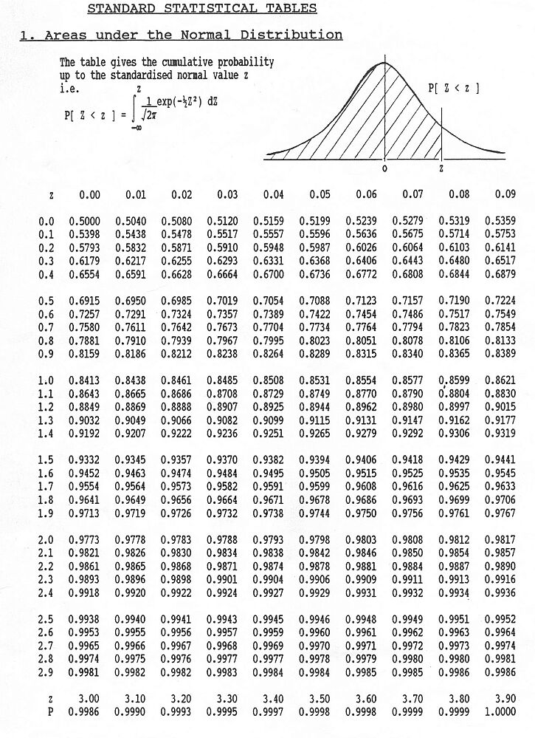
35

Slide 36
Problem 11:
If a random variable has the standard normal distribution, find the probability that it will take on a value
a)less than 1.75 = P(Z < 1.75) = F(1.75) = 0.9599
b)less than -1.25 = P(Z < -1.25) = F(-1.25) = 1 –F(1.25) = 0.1056
c)greater than 2.06 = P(Z >2.06) = 1 – F(2.06) = 0.0197
d)greater than -1.82 = P(Z > -1.82) = 1- F(-1.82) =1-0.0344=0.9656
P(Z > -1.82) = 1 –F(-1.82) = 1 –(1 – F(1.82) = F(1.82) = 0.9656
36

Slide 37
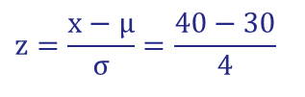
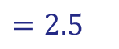
Problem 12:
Scores on a particular test are normally distributed with a mean of 30 and standard deviation of 4. What is the probability of anyone scoring less than 40?
$$z=\frac{x−μ}{σ}=\frac{40−30}{4}$$
$$=2.5$$
μ = 30
σ = 4
P(x < 40)
x
μ =30
40
z
μ =0
?
2.5
P(x < 40) = P(z < 2.5) = 0.9938
The probability that a student receives a test score less than 90 is 0.9938.
37

Slide 38
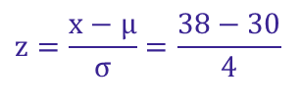
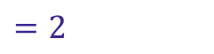
Problem 13:
Scores on a particular test are normally distributed with a mean of 30 and standard deviation of 4. What is the probability of anyone scoring greater than 38?
$$z=\frac{x−μ}{σ}=\frac{38−30}{4}$$
$$=2$$
μ = 30
σ = 4
P(x > 35)
x
μ =30
38
z
μ =0
2.0
?
P(x > 38) = P(z > 2) = 1 − P(z < 2) = 1 − 0.9773 = 0.0227
The probability that a student receives a test score greater than 38 is 0.0227
38

Slide 39

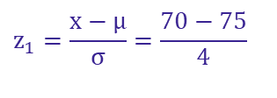



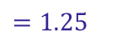
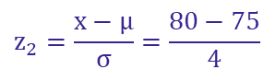

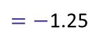



Problem 14:
The average on a statistics test was 75 with a standard deviation of 4. If the test scores are normally distributed, find the probability that a student receives a test score between 70 and 80.
$$z_{1}=\frac{x−μ}{σ}=\frac{70−75}{4}$$
$=−$1.25
P(70 < x < 80)
$$z_{2}=\frac{x−μ}{σ}=\frac{80−75}{4}$$
$$=1.25$$
μ = 75
σ = 4
The probability that a student receives a test score between 70 and 80 is 0.7888
x
70
μ =75
80
z
−1.25
μ =0
1.25
?
?
P(70 < x < 80) = P(−1.25 < z < 1.25) = F(1.25) − F( −1.25)
= 0.8944 − 0.1056 = 0.7888
39

Slide 40
Problem 15:
If X is a normal variate with mean 30 and SD 5. Find the probabilities that
(i) 26≤ X ≤ 40 (ii) X > 45
Solution :
Here, mean μ= 30 and standard deviation σ = 5
(i) When X = 26
Z= (X - µ)/ σ= (26 – 30)/5 = –0.8 and
when X = 40 , Z = (40-30)/ 5= 2
Therefore, P(26 ≤ X ≤ 40) = P(–0.8 ≤ Z ≤ 0) + p(0 ≤ Z ≤ 2)
= P(0 ≤ Z ≤ 0.8) + P(0 ≤ Z ≤ 2)
= 0.2881 + 0.4772 (By tables) = 0.7653
(ii) P( X ≥ 45) = P(Z ≥ 3) = 0.5 – 0.49865 = 0.00135
40

Slide 41
Problem 16:
Butterfly-style valves used in heating and ventilating industries have a high flow
coefficient. Flow coefficient can be modeled by a normal distribution with mean
496 C_{v} and standard deviation 25C_{v}. Find the probability that a valve will have a
flow coefficient of
atleast 450C_{v}
P(X > 450) = P[( 450 – 496) /25] = P(Z > -1.84) = 1 – F(-1.84) = 1- 00329 = .9671
b) between 445.5 and 522C_{v}
P(445.5 <X <522) = P(-2.02 <Z <1.04) = F(1.04) – F(-2.02)= 0.8508 – 0.0217 =0.8291
41

Slide 42
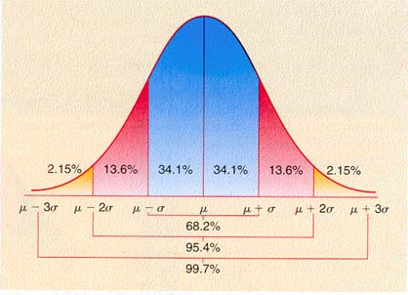
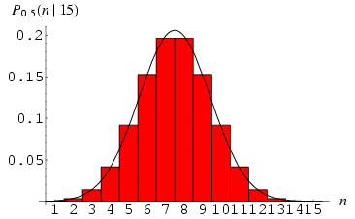
Normal Distribution
Change in Mean determines the shift in the distribution
Change in the deviation determines the spread of the data points
μ = mean
σ = standard deviation
π = 3.14159
e = 2.71828
This is a bell-shaped curve with different centers and spreads depending on μ and σ.
42
Notes:
RV is a Non-Negative Integer starting from 0.

Slide 43
Normal Approximation
The normal distribution is used to approximate the binomial distribution when it would be impractical to use the binomial distribution to find a probability.
Normal Approximation to a Binomial Distribution
If np ≥ 15 and nq ≥15, then the binomial random variable x is approximately normally distributed with mean
and standard deviation
43

Slide 44
Problem 17:
Decide whether the normal distribution to approximate x may be used in the following examples:
In a survey of 8 to 18-year-old heavy media users in the United States,47% said they get fair or poor grades (C’s or below). You randomly select forty-five 8 to 18-year-old heavy media users in the United States and ask them whether they get fair or poor grades.
Solution:
np = 45(0.47) = 21.15
nq = 45(0.53) = 23.85.
44

Slide 45
2. Thirty-six percent of people in the United States own a dog. You randomly select 25 people in the United States and ask them if they own a dog.
Solution:
Because np is not greater than 15, the normal distribution may NOT be used.
45

Slide 46
Problem 18:
Thirty-one percent of the seniors in a certain high school plan to attend college. If 50 students are randomly selected, find the probability that less than 14 students plan to attend college by normal approximation.
Solution:
np = (50)(0.31) = 15.5
The variable x is approximately normally distributed with μ = np = 15.5 and
nq = (50)(0.69) = 34.5
P(x < 13.5)
= P(z < −0.61)
= 0.2709
μ= 15.5
Correction for continuity
13.5
x
10
15
20
The probability that less than 14 plan to attend college is 0.2709.
46

Slide 47
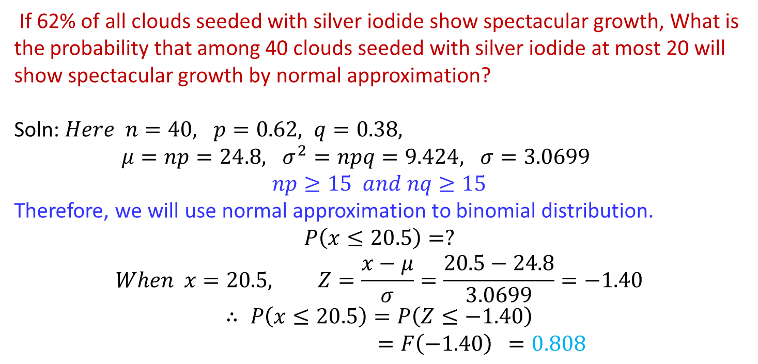
Problem 19:
If 62% of all clouds seeded with silver iodide show spectacular growth, What is the probability that among 40 clouds seeded with silver iodide at most 20 will show spectacular growth by normal approximation?
Soln: $Here n=40, p=0.62, q=0.38,$
$μ=np=24.8, σ^{2}=npq=9.424, σ=3.0699$
$$np≥15 and nq≥15$$
Therefore, we will use normal approximation to binomial distribution.
$$P\left(x≤20.5\right)=?$$
$$When x=20.5, Z=\frac{x−μ}{σ}=\frac{20.5−24.8}{3.0699}=−1.40$$
$$∴ P\left(x≤20.5\right)=P\left(Z≤−1.40\right)$$
$=F\left(−1.40\right)$ $=0.808$
47

Slide 48
Self - study

Slide 49
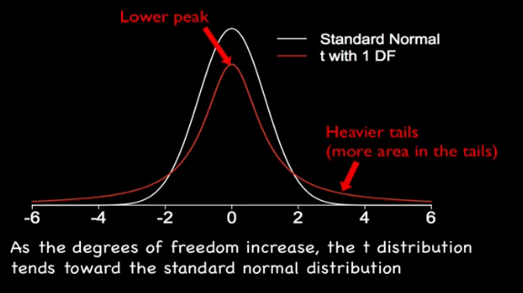
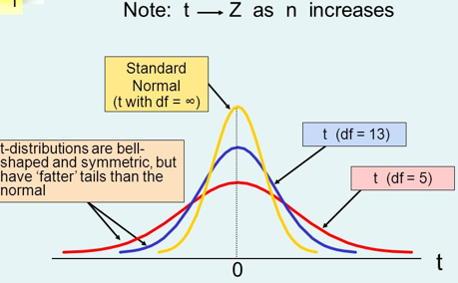
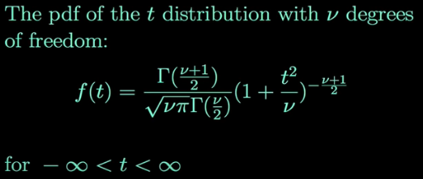
Introduction to t-distribution

Slide 50
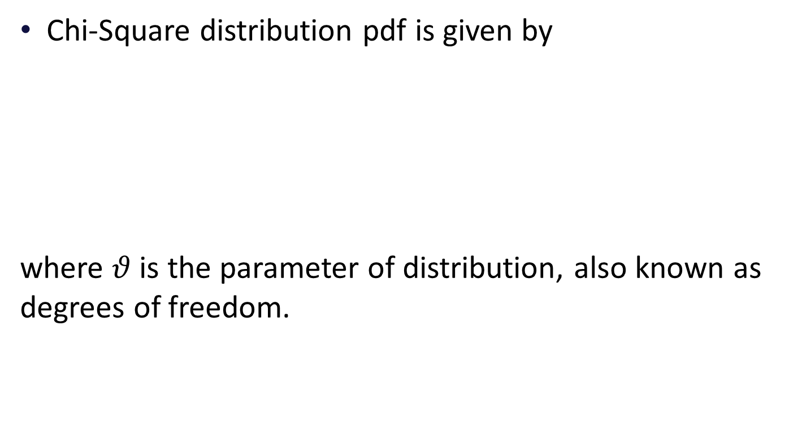
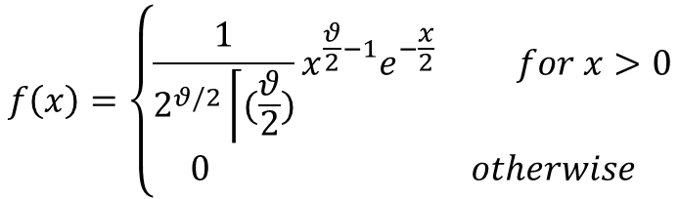
Introduction to Chi- Square( ) distribution
Chi-Square distribution pdf is given by
where $θ$ is the parameter of distribution, also known as degrees of freedom.
$$f\left(x\right)=\left\{\begin{aligned}\frac{1}{2^{θ/2}\left\lceil (\frac{θ}{2})\right.}x^{\frac{θ}{2}−1}e^{−\frac{x}{2}} for x>0 \\ 0 otherwise\end{aligned}\right.$$
50

Slide 51
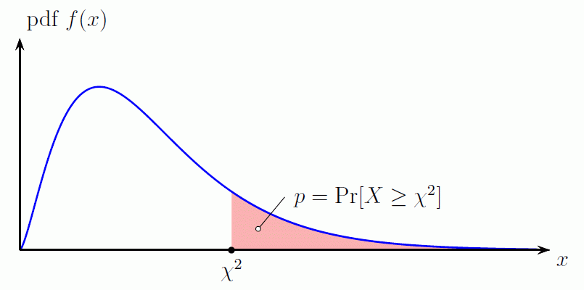
Introduction to Chi- Square( ) distribution
51

Slide 52
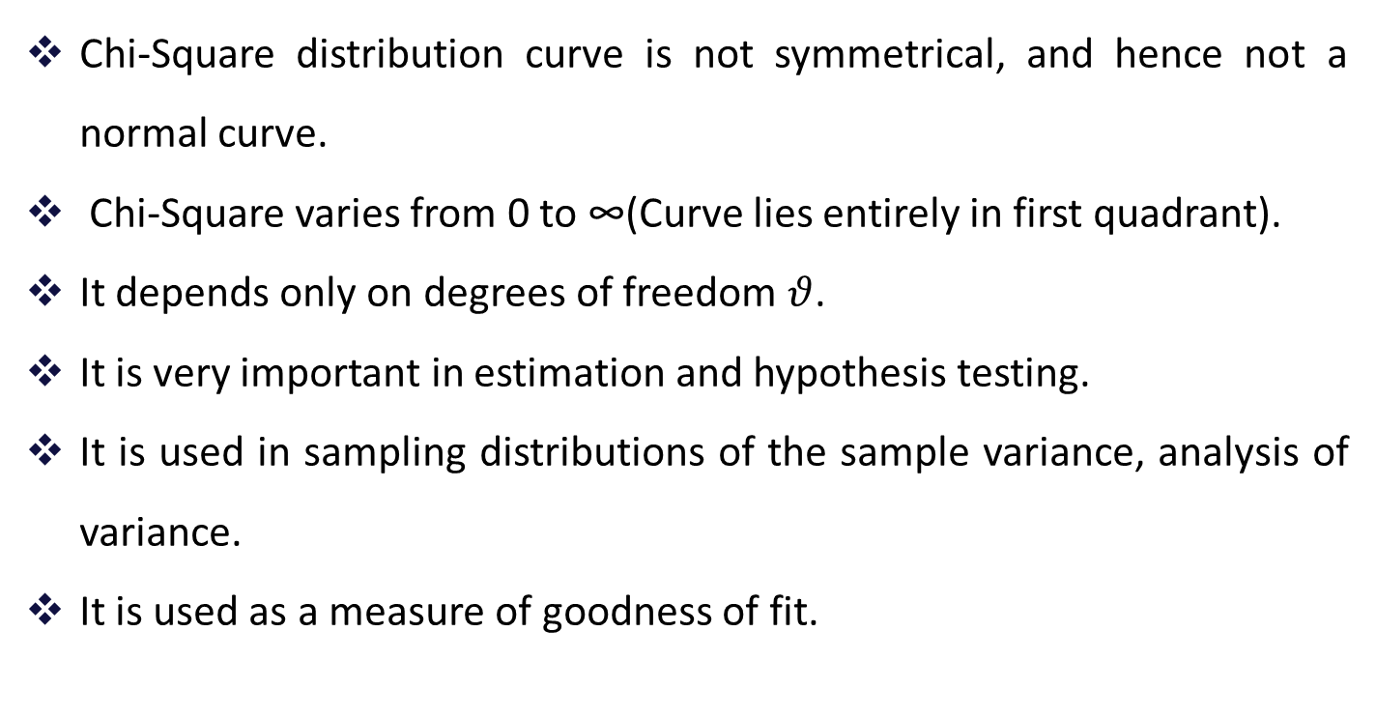
Introduction to Chi- Square( ) distribution
Chi-Square distribution curve is not symmetrical, and hence not a normal curve.
Chi-Square varies from 0 to ∞(Curve lies entirely in first quadrant).
It depends only on degrees of freedom $θ$.
It is very important in estimation and hypothesis testing.
It is used in sampling distributions of the sample variance, analysis of variance.
It is used as a measure of goodness of fit.
52

Slide 53
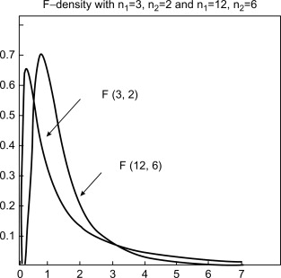
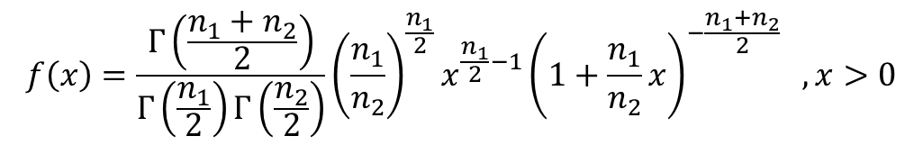
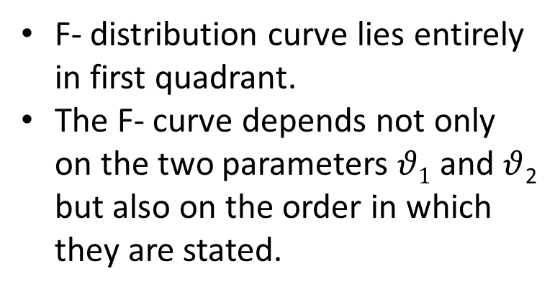
Introduction to F-distribution
(Sampling distribution of the ratio of two sample variances)
The pdf for a random variable X ~ F (n₁, n₂) is given by
$$f\left(x\right)=\frac{Γ\left(\frac{n_{1}+n_{2}}{2}\right)}{Γ\left(\frac{n_{1}}{2}\right)Γ\left(\frac{n_{2}}{2}\right)}{\left(\frac{n_{1}}{n_{2}}\right)}^{\frac{n_{1}}{2}}x^{\frac{n_{1}}{2}−1}{\left(1+\frac{n_{1}}{n_{2}}x\right)}^{−\frac{n_{1}+n_{2}}{2}} ,x>0$$
F- distribution curve lies entirely in first quadrant.
The F- curve depends not only on the two parameters $θ1$ and $θ$₂ but also on the order in which they are stated.
53

Slide 54
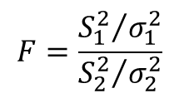
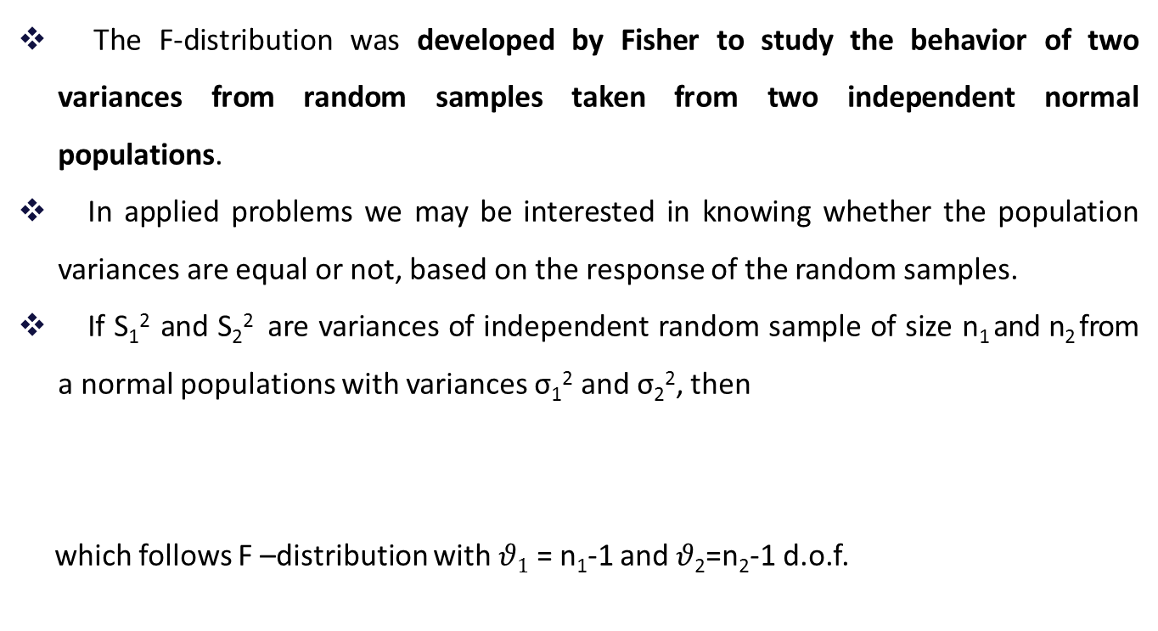
Introduction to F-distribution
(Sampling distribution of the ratio of two sample variances)
The F-distribution was developed by Fisher to study the behavior of two variances from random samples taken from two independent normal populations.
In applied problems we may be interested in knowing whether the population variances are equal or not, based on the response of the random samples.
If S₁² and S₂² are variances of independent random sample of size n₁ and n₂ from a normal populations with variances σ₁² and σ₂², then
which follows F –distribution with $θ1$ = n₁-1 and $θ$₂=n₂-1 d.o.f.
$$F=\frac{{S_{1}^{2}}/{σ_{1}^{2}}}{{S_{2}^{2}}/{σ_{2}^{2}}}$$
54

Slide 55
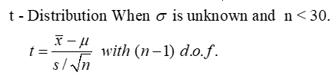

Introduction to t-distribution (Sampling distribution of mean when $σ$ unknown)
The t-distribution, also known as the Student's t-distribution, is a type of probability distribution that is similar to the normal distribution with its bell shape but has heavier tails.
It is used for estimating population parameters for small sample sizes when we don't know the standard deviation.
Where sample S.D. is calculated by formula
55

Slide 56
Practice Problems
1.
In a factory, 8% of all machines break down at least once a year. Use the Poisson approximation to the binomial distribution to determine the probabilities that among 25 machines (randomly chosen in the factory):
5 will break down at least once a year;
at least 4 will break down once a year:
anywhere from 3 to 8, inclusive, will break down at least once a year.
56

Slide 57
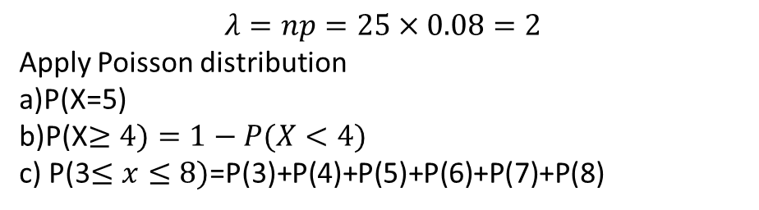
Solution:
$$λ=np=25×0.08=2$$
Apply Poisson distribution
a)P(X=5)
b)P(X$≥4)=1−P(X<4)$
c) P(3$≤x≤8)$=P(3)+P(4)+P(5)+P(6)+P(7)+P(8)
57

Slide 58
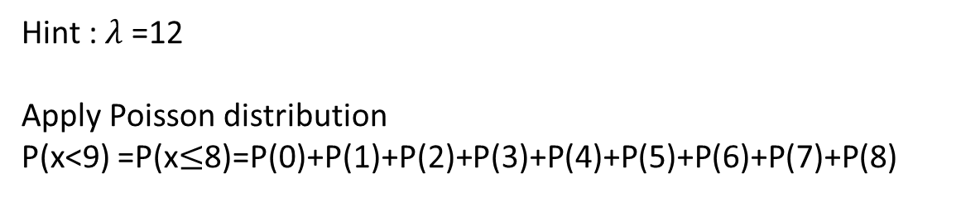
Practice Problems
2.
The average number of trucks arriving on any one day at a truck depot in a certain city is known to be 12. what is the probability that on a given day fewer than nine trucks will arrive at this depot?
Hint : $λ$ =12
Apply Poisson distribution
P(x<9) =P(x$≤$8)=P(0)+P(1)+P(2)+P(3)+P(4)+P(5)+P(6)+P(7)+P(8)
58

Slide 59
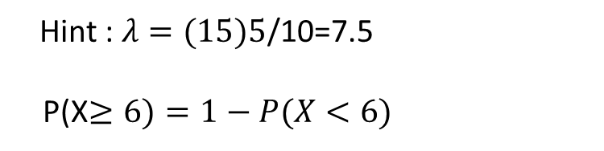
Practice Problems
A certain kind of sheet metal has on the average, five defects per 10 square feet. If we assume a Poisson distribution, what is the probability that a 15-square-foot sheet of the metal will have at least six defects?
3.
Hint : $λ=(15)5$/10=7.5
P(X$≥6)=1−P(X<6)$
59

Slide 60
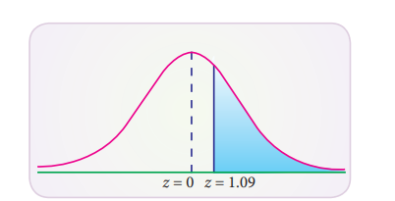
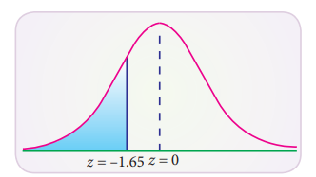
Practice Problems
4. What is the probability that a standard normal variate Z will be
(i) greater than 1.09
(ii) less than –1.65
(iii) lying between –1.00 and 1.96
(iv) lying between 1.25 and 2.75
Solution :
(i) greater than 1.09
The total area under the curve is equal to 1 , so that the total area to the right Z = 0 is 0.5 (since the curve is symmetrical).
The area between Z = 0 and 1.09 (from tables) is 0.3621
P(Z > 1.09) = 0.5000 – 0.3621 = 0.1379
The shaded area to the right of Z = 1.09 is the probability that Z will be greater than 1.09.
(ii) less than –1.65
The area between –1.65 and 0 is the same as area between 0 and 1.65.
In the table the area between zero and 1.65 is 0.4505
(from the table). Since the area to the left of zero is 0.5,
P(Z< 1.65) = 0.5000 – 0.4505 = 0.0495
60

Slide 61
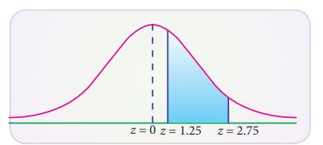
(iii) lying between –1.00 and 1.96
The probability that the random variable Z in between –1.00 and 1.96 is found by adding the corresponding areas :
Area between –1.00 and 1.96 = area between (–1.00 and 0) + area betwn (0 and 1.96) P(–1.00 < Z < 1.96) = P(–1.00 < Z < 0) + P(0 < Z < 1.96) = 0.3413 + 0.4750 (by tables) = 0.8163
(iv) lying between 1.25 and 2.75:
Area between Z = 1.25 and 2.75 = area between (z = 0 and z = 2.75) – area between (z=0 and z = 1.25)
P(1.25 < Z < 2.75) = P(0 < Z < 2.75) – P(0 < Z < 1.25) = 0.4970 – 0.3944 = 0.1026
61

Slide 62
Practice Problems
5. The length of life of an instrument produced by a machine has a normal distribution with a mean of 12 months and a standard deviation of 2 months. Find the probability that an instrument produced by this machine will last a) less than 7 months. b) between 7 and 12 months.
Solution: a) P(x < 7) = P(z < -2.5)= 0.0062
Hint: b) P( 7< x <12)
b) P(7 < x < 12) = P(-2.5 < z < 0)= 0.4938
62

Slide 63
Practice Problems
6. A computer crashes on average once every 4 months; a) What is the probability that it will not crash in a period of 4 months? b) What is the probability that it will crash once in a period of 4 months? c) What is the probability that it will crash twice in a period of 4 months? d) What is the probability that it will crash three times in a period of 4 months?
Hint:
63

Slide 64
Practice Problems
7. If mean of the binomial distribution is 20 and the number of observations is 30. Find the variance and standard deviation.
Hint: n =30, np = 20;
8. The probability of a boy hitting a target is 0.2. How Many times must he fire so that the probability of his hitting the target at least once is greater than 2/3.
Hint: p= 0.2; P(X>=1) = 2/3, find n.
9. A box of candies has many different colors in it. There is a 15% chance of getting a pink candy. What is the probability that exactly 4 candies in a box are pink out of 10?
Hint: n = 10, p=0.15, q=0.85, x=4, Solution: P(x=4)= 0.04;
64

Slide 65

IMP Note to Self

Slide 66
Thank you

